Slide 1
Intro to Arduino
Zero to Prototyping
in a Flash!
Material designed by Linz Craig, Nick Poole, Prashanta Aryal,
Theo Simpson, Tai Johnson, and Eli Santistevan

Slide 2
Overview of Class
Getting Started:
Installation, Applications and Materials
Electrical:
Components, Ohm's Law, Input and Output, Analog and Digital
-----------------------------
Programming:
Split into groups depending on experience
Serial Communication Basics:
Troubleshooting and Debugging
Virtual Prototyping:
Schematics and PCB Layout in Fritzing

Slide 3


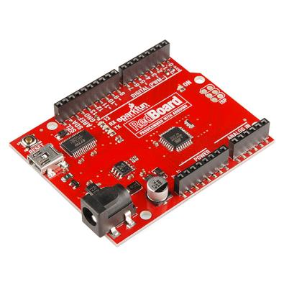
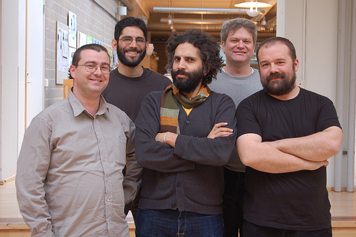
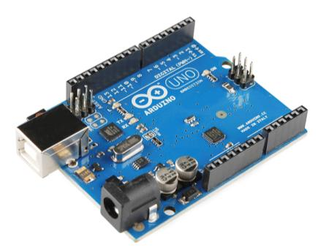
Arduino Board
“Strong Friend” Created in Ivrea, Italy
in 2005 by Massimo Banzi & David Cuartielles
Open Source Hardware
Processor
Coding is accessible & transferrable → (C++, Processing, java)

Slide 4
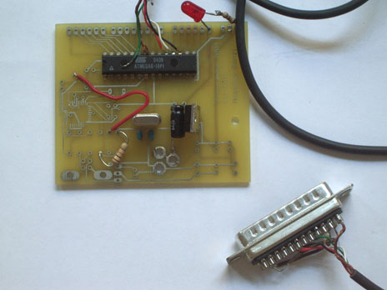
Arduino…
is the go-to gear for artists, hobbyists, students, and anyone with a gadgetry dream.
rose out of another formidable challenge: how to teach students to create electronics, fast.
http://spectrum.ieee.org/geek-life/hands-on/the-making-of-arduino

Slide 5
Getting Started
SW Installation: Arduino (v.1.0+)
Fritzing
SIK Guide Code
Drivers (FTDI)
Materials: SIK Guide
Analog I/O, Digital I/O, Serial, & Fritzing handouts
Arduino CheatSheet

Slide 6
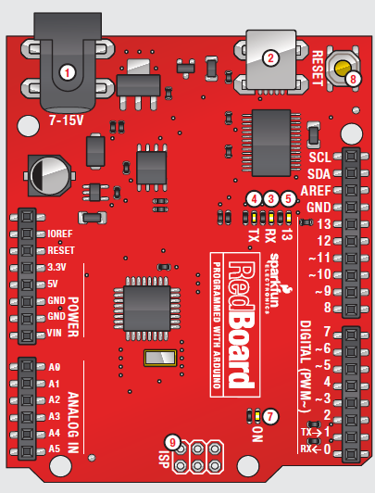
PWR IN
USB
(to Computer)
RESET
SCL\SDA
(I2C Bus)
POWER
5V / 3.3V / GND
Digital I\O
PWM(3, 5, 6, 9, 10, 11)
Analog INPUTS
Notes:
Look up analog ref

Slide 7
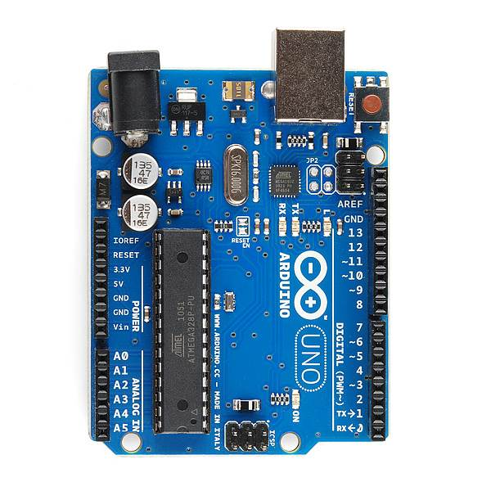
PWR IN
USB
(to Computer)
RESET
SCL\SDA
(I2C Bus)
POWER
5V / 3.3V / GND
Digital I\O
PWM(3, 5, 6, 9, 10, 11)
Analog INPUTS
Notes:
Look up analog ref

Slide 8
Notes:
Look up analog ref

Slide 9
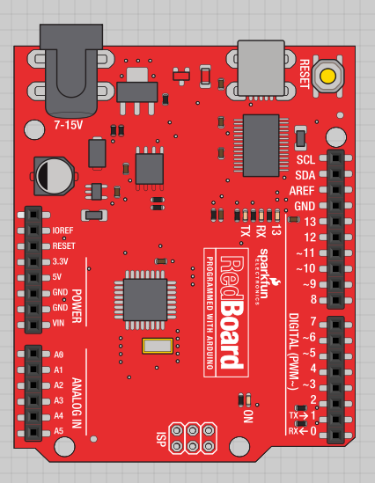

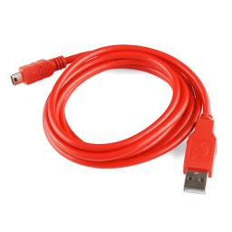
Go ahead and plug your board in!

Slide 10
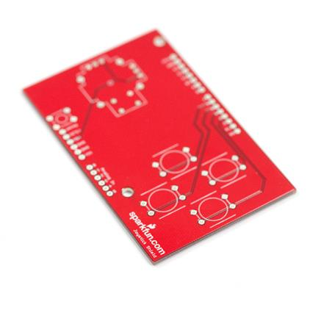
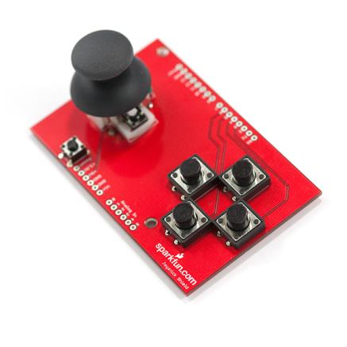
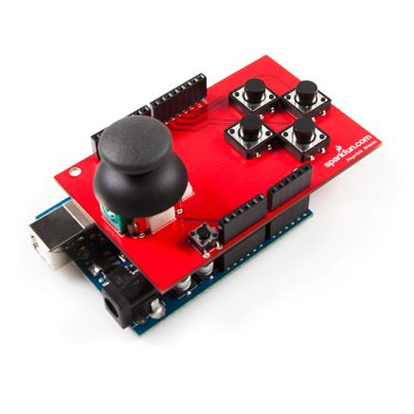
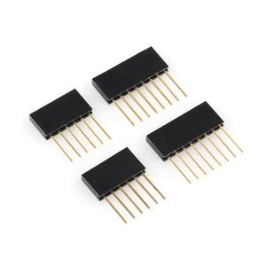
Arduino Shields
PCB
Built Shield
Inserted Shield

Slide 11
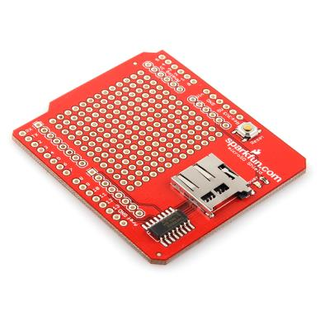
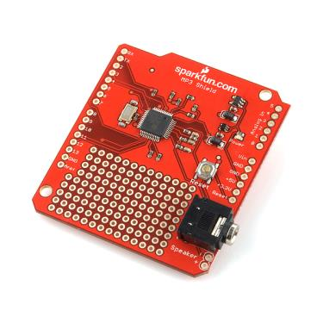
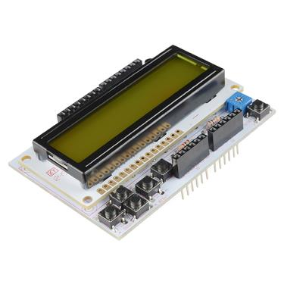
Arduino Shields
Micro SD
MP3 Trigger
LCD

Slide 12
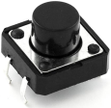
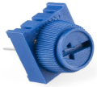
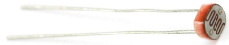
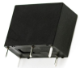
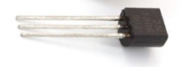
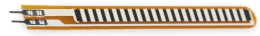
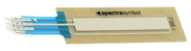

SIK Components
Name | Image | Type | Function | Notes
Push Button |  | Digital Input | Switch - Closes or opens circuit | Polarized, needs resistor
Trim potentiometer |  | Analog Input | Variable resistor | Also called a Trimpot.
Photoresistor |  | Analog Input | Light Dependent Resistor (LDR) | Resistance varies with light.
Relay |  | Digital Output | Switch driven by a small signal | Used to control larger voltages
Temp Sensor |  | Analog Input | Temp Dependent Resistor
Flex Sensor |  | Analog Input | Variable resistor
Soft Trimpot |  | Analog Input | Variable resistor | Careful of shorts
RGB LED |  | Dig & Analog Output | 16,777,216 different colors | Ooh... So pretty.

Slide 13
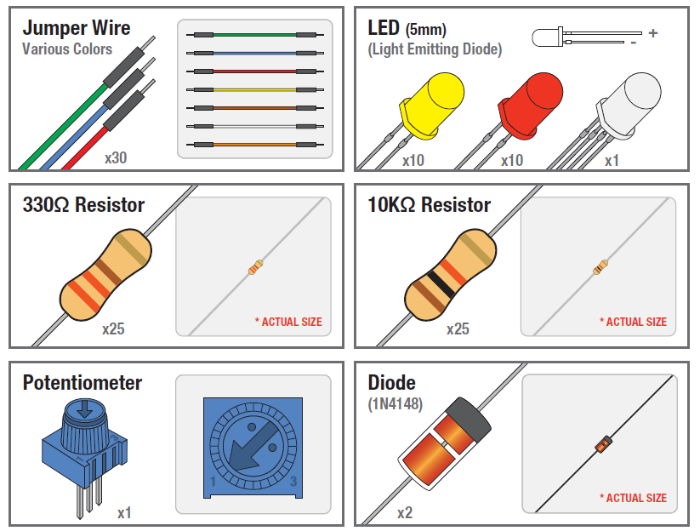
SIK Components

Slide 14
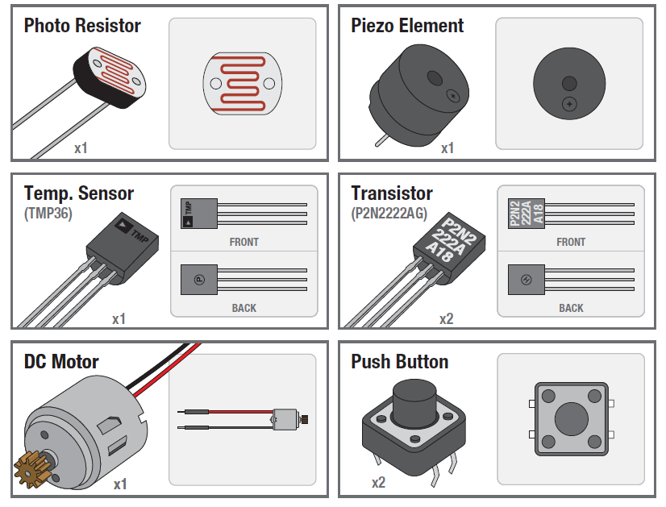
SIK Components

Slide 15
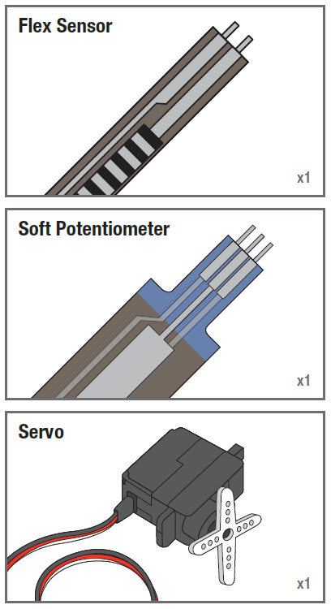
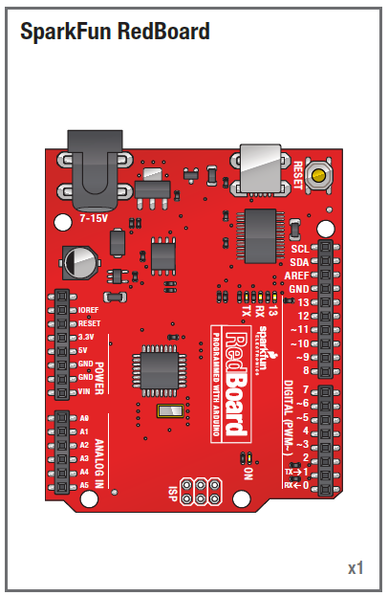
SIK Components

Slide 16
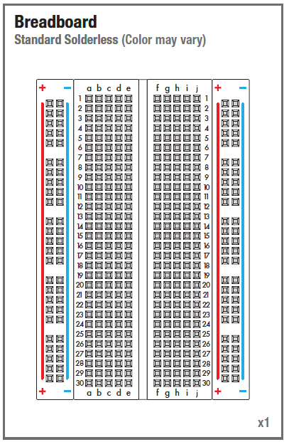
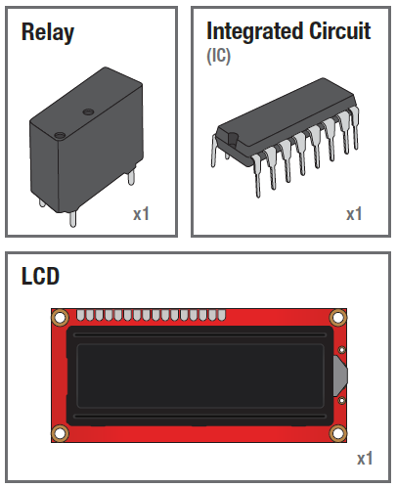

Slide 17
Electricity \ Electronics Basic Concept Review
Ohms Law
Voltage
Current
Resistance
Using a Multi-meter

Slide 18
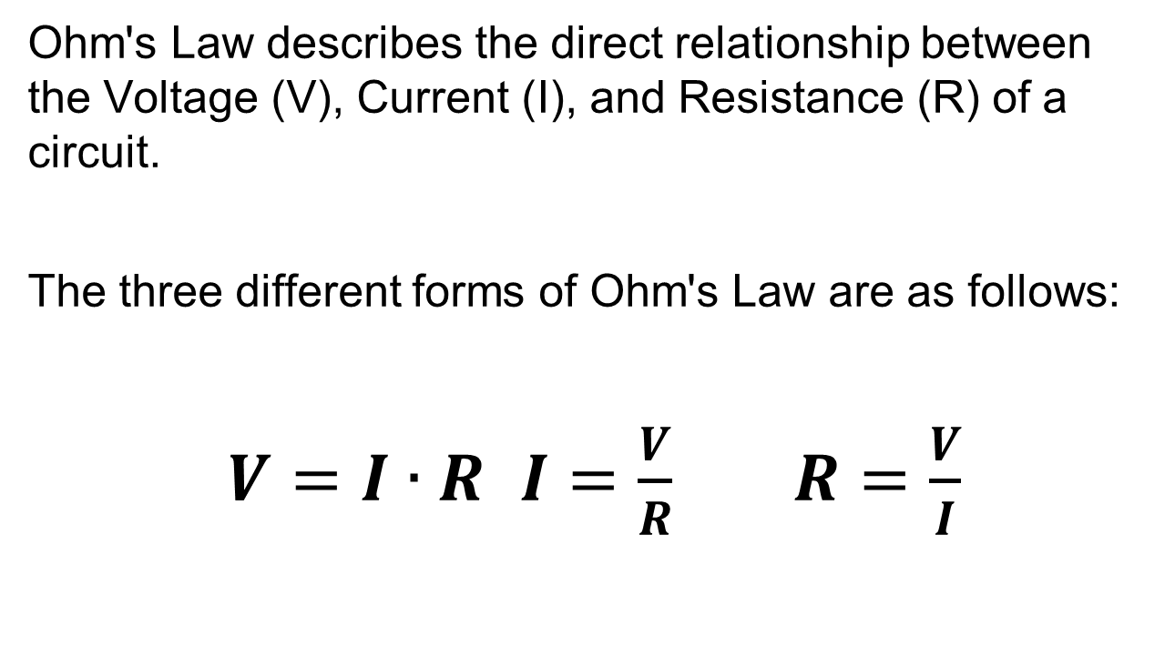
Ohm’s Law

Slide 19

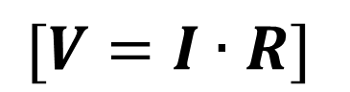
Electrical Properties
Voltage
V
Defined as the amount of potential energy in a circuit.
Current
I
The rate of charge flow in a circuit.
Units: Amperes (A)
Resistance
R
Units: Volts (V)

Slide 20


Current Flow Analogy
High Current
Low Current

Slide 21

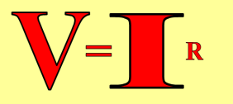

Voltage Analogy
Water
Tower
Water
Tower
V
V
More Energy == Higher Voltage
Less Energy == Lower Voltage

Slide 22


Resistance Analogy
Water
Tower
Water
Tower
V
Big Pipe == Lower Resistance
Small Pipe == Higher Resistance

Slide 23
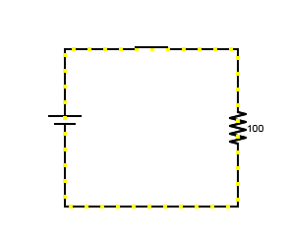
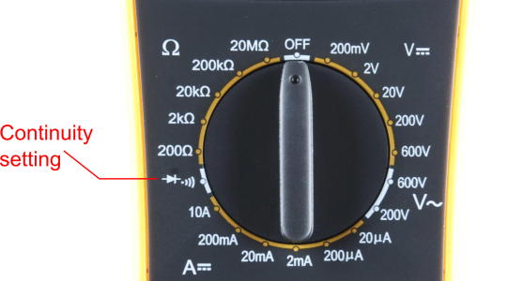
Continuity – Is it a Circuit?
The word “circuit” is derived from the circle. An Electrical Circuit must have a continuous LOOP from Power (V_{cc}) to Ground (GND).
Continuity is important to make portions of circuits are connect. Continuity is the simplest and possibly the most important setting on your multi-meter. Sometimes we call this “ringing out” a circuit.

Slide 24
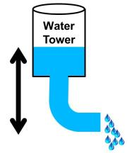
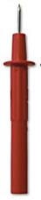
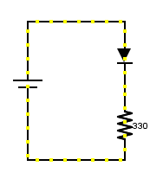
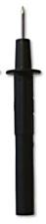
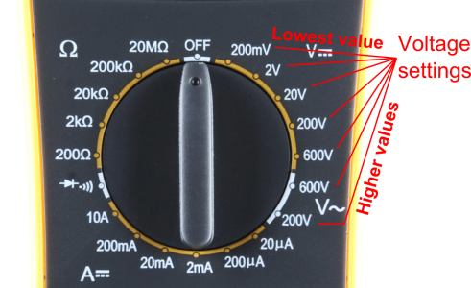
Measuring Electricity – Voltage
Voltage is a measure of potential electrical energy. A voltage is also called a potential difference – it is measured between two points in a circuit – across a device.

Slide 25
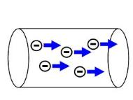
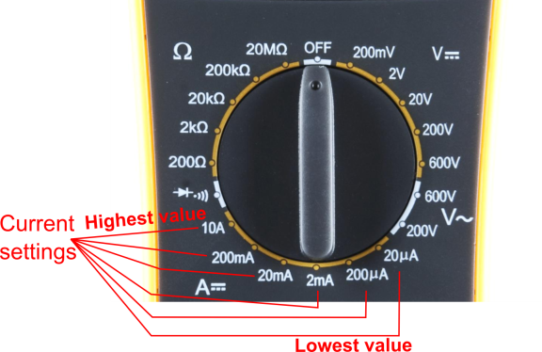
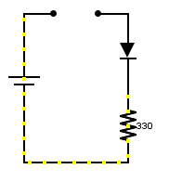
Measuring Electricity -- Current
Current is the measure of the rate of charge flow. For Electrical Engineers – we consider this to be the movement of electrons.
In order to measure this – you must break the circuit or insert the meter in-line (series).

Slide 26
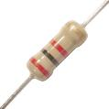
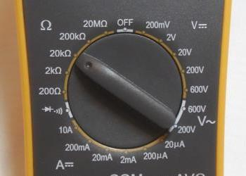
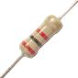
Measuring Electricity -- Resistance
Resistance is the measure of how much opposition to current flow is in a circuit.
Components should be removed entirely from the circuit to measure resistance. Note the settings on the multi-meter. Make sure that you are set for the appropriate range.
Resistance
settings

Slide 27
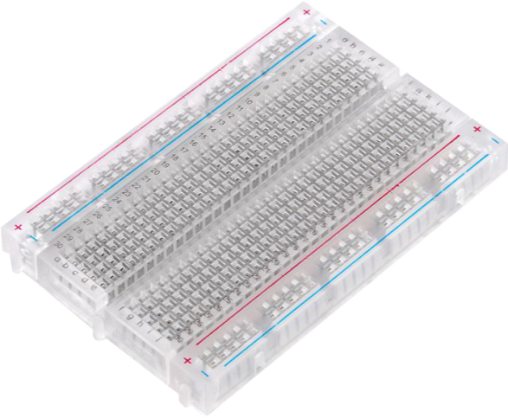
Prototyping Circuits Solderless Breadboard
One of the most useful tools in an engineer or Maker’s toolkit. The three most important things:
A breadboard is easier than soldering
A lot of those little holes are connected, which ones?
Sometimes breadboards break

Slide 28
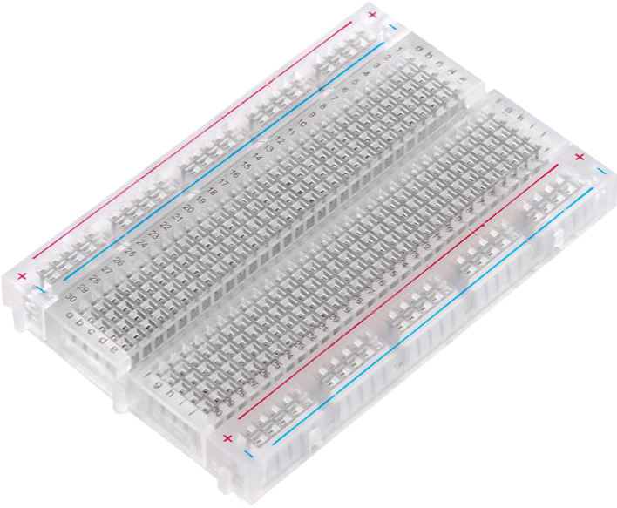
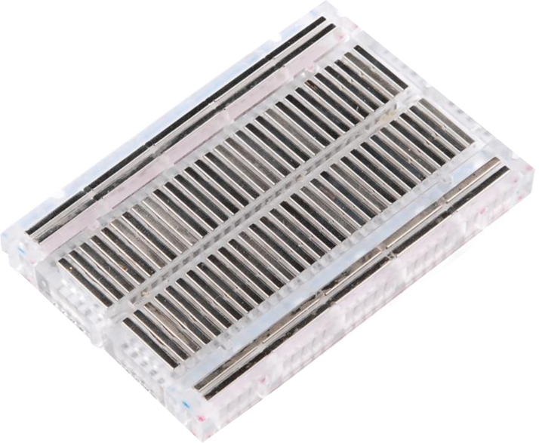
What’s a Breadboard?

Slide 29
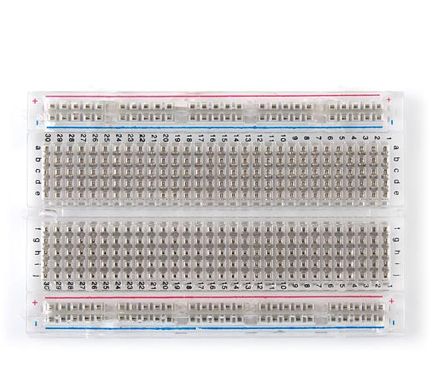
Solderless Breadboard
Each row (horiz.) of 5 holes are connected.
Vertical columns – called power bus are connected vertically

Slide 30
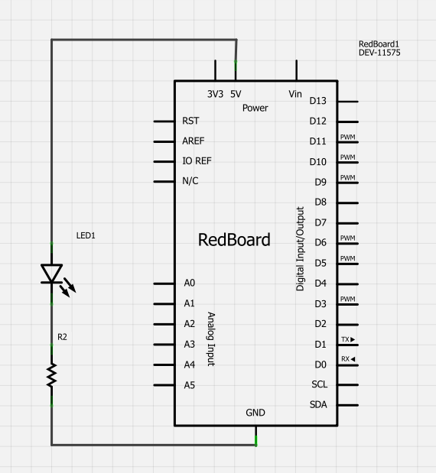
Using the Breadboard to built a simple circuit
Use the breadboard to wire up a single LED with a 330 Ohm Resistor (Orange-Orange-Brown).
Note: the longer leg on the LED is the positive leg and the shorter leg is the negative

Slide 31
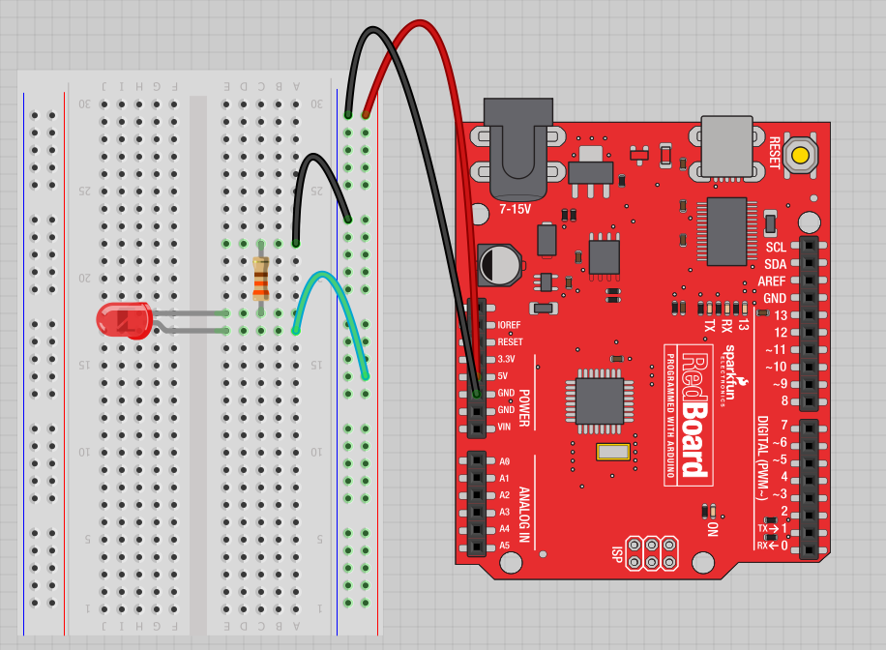
Fritzing View of Breadboard Circuit
What happens when you break the circuit?
What if you wanted to add more than one LED?

Slide 32

Adding control – let’s use the Arduino and start programming!!!

Slide 33

Concepts: INPUT vs. OUTPUT
Referenced from the perspective of the microcontroller (electrical board).
Inputs is a signal / information going into the board.
Output is any signal exiting the board.
Almost all systems that use physical computing will have some form of output
What are some examples of Outputs?

Slide 34
Concepts: INPUT vs. OUTPUT
Referenced from the perspective of the microcontroller (electrical board).
Inputs is a signal / information going into the board.
Output is any signal exiting the board.
Examples: Buttons Switches, Light Sensors, Flex Sensors, Humidity Sensors, Temperature Sensors…
Examples: LEDs, DC motor, servo motor, a piezo buzzer, relay, an RGB LED

Slide 35

Concepts: Analog vs. Digital
Microcontrollers are digital devices – ON or OFF. Also called – discrete.
analog signals are anything that can be a full range of values. What are some examples? More on this later…
5 V
5 V
0 V
0 V

Slide 36

Open up Arduino
Hints:
For PC Users →
Let the installer copy and move the files to the appropriate locations, or
Create a folder under C:\Program Files (x86) called Arduino. Move the entire Arduino program folder here.
For Mac Users →
Move the Arduino executable to the dock for ease of access.
Resist the temptation to run these from your desktop.

Slide 37

Arduino Integrated Development Environment (IDE)
Two required functions / methods / routines:
void setup()
{
// runs once
}
void loop()
{
// repeats
}
error & status messages
Notes:
Be sure to point out the what all of the buttons do.

Slide 38

Settings: Tools → Serial Port
Your computer communicates to the Arduino microcontroller via a serial port → through a USB-Serial adapter.
Check to make sure that the drivers are properly installed.
Notes:
All connections to computers- mice, printers etc use a serial port. Gotta pick the right one.

Slide 39

Settings: Tools → Board
Next, double-check that the proper board is selected under the Tools→Board menu.
Notes:
All connections to computers- mice, printers etc use a serial port. Gotta pick the right one.

Slide 40








Arduino & Arduino Compatible Boards

Slide 41
digitalWrite()
analogWrite()
digitalRead()
if() statements / Boolean
analogRead()
Serial communication
BIG 6 CONCEPTS
This work is licensed under a Creative Commons Attribution-ShareAlike 3.0 United States License.

Slide 42
Let’s get to coding…
Project #1 – Blink
“Hello World” of Physical Computing
Psuedo-code – how should this work?
Turn LED ON
Wait
Turn LED OFF
Wait
Rinse & Repeat

Slide 43
Comments, Comments, Comments
Comments are for you – the programmer and your friends…or anyone else human that might read your code.
// this is for single line comments
// it’s good to put a description at the top and before anything ‘tricky’
/* this is for multi-line comments
Like this…
And this….
*/

Slide 44

comments
Notes:
Review the two main parts of the sketch – void setup() and void loop()
Provide rationale for good commenting.
Emphasize the need for good / clean coding practices like indenting.

Slide 45
Three commands to know…
pinMode(pin, INPUT/OUTPUT);
ex: pinMode(13, OUTPUT);
digitalWrite(pin, HIGH/LOW);
ex: digitalWrite(13, HIGH);
delay(time_ms);
ex: delay(2500); // delay of 2.5 sec.
// NOTE: -> commands are CASE-sensitive
Notes:
Three commands to rule the world… or at least do 80% of cool Arduino projects.

Slide 46

Project #1: Wiring Diagram
Move the green wire from the power bus to pin 13 (or any other Digital I/O pin on the Arduino board.
Image created in Fritzing

Slide 47
A few simple challenges Let’s make LED#13 blink!
Challenge 1a – blink with a 200 ms second interval.
Challenge 1b – blink to mimic a heartbeat
Challenge 1c – find the fastest blink that the human eye can still detect…
1 ms delay? 2 ms delay? 3 ms delay???

Slide 48

Try adding other LEDs

Slide 49

Programming Concepts: Variables
Variable Scope
Global
---
Function-level

Slide 50



Programming Concepts: Variable Types
Variable Types:
8 bits
16 bits
32 bits
byte
char
int
unsigned int
long
unsigned long
float

Slide 51
Fading in and Fading Out (Analog or Digital?)
A few pins on the Arduino allow for us to modify the output to mimic an analog signal.
This is done by a technique called:
Pulse Width Modulation (PWM)

Slide 52

Concepts: Analog vs. Digital
To create an analog signal, the microcontroller uses a technique called PWM. By varying the duty cycle, we can mimic an “average” analog voltage.
Pulse Width Modulation (PWM)

Slide 53

Project #2 – Fading Introducing a new command…
analogWrite(pin, val);
pin – refers to the OUTPUT pin (limited to pins 3, 5, 6, 9, 10, 11.) – denoted by a ~ symbol
val – 8 bit value (0 – 255).
0 => 0V | 255 => 5V

Slide 54

Move one of your LED pins over to Pin 9
In Arduino, open up:
File → Examples → 01.Basics → Fade

Slide 55

Fade - Code Review

Slide 56

Fade - Code Review

Slide 57
Project# 2 -- Fading
Challenge 2a – Change the rate of the fading in and out. There are at least two different ways to do this – can you figure them out?
Challenge 2b – Use 2 (or more) LEDs – so that one fades in as the other one fades out.

Slide 58



Color Mixing Tri-color LED
R
G
B
In the SIK, this is a standard – Common Cathode LED
This means the negative side of the LED is all tied to Ground.

Slide 59


Project 3 – RGB LED
Note: The longest leg of the RGB LED is the Common Cathode. This goes to GND.
Use pins 5, 6, & 9

Slide 60


How many unique colors can you create?
Use Colorpicker.com or experiment on your own.
Pick out a few colors that you want to try re-creating for a lamp or lighting display...
Play around with this with the analogWrite() command.

Slide 61
RGB LED Color Mixing
int redPin = 5;
int greenPin = 6;
int bluePin = 9;
void setup()
{
pinMode(redPin, OUTPUT);
pinMode(greenPin, OUTPUT);
pinMode(bluePin, OUTPUT);
}

Slide 62
RGB LED Color Mixing
void loop()
{
analogWrite(redPin, 255);
analogWrite (greenPin, 255);
analogWrite (bluePin, 255);
}

Slide 63



Project: Mood Lamp / Light Sculpture
Notes:
Here are a few examples of project ideas that you can extend this to in the class.

Slide 64


Napkin Schematics
Emphasize the engineering design process with students. We like to skirt the line between formal and informal with a tool called Napkin Schematics.

Slide 65


Napkin Schematics
Emphasize the engineering design process with students. We like to skirt the line between formal and informal with a tool called Napkin Schematics.

Slide 66


Driving Motors or other High Current Loads
NPN Transistor (Common Emitter “Amplifier” Circuit)
to Digital
Pin 9

Slide 67


Input
Input is any signal entering an electrical system .
Both digital and analog sensors are forms of input
Input can also take many other forms: Keyboards, a mouse, infrared sensors, biometric sensors, or just plain voltage from a circuit

Slide 68
Project #4 – Digital Input
In Arduino, open up:
File → Examples → 02.Digital → Button

Slide 69


Digital Sensors (a.k.a. Switches) Pull-up Resistor (circuit)
to Digital Pin 2

Slide 70


Digital Sensors (a.k.a. Switches) Add an indicator LED to Pin 13
This is just like our 1st circuit!

Slide 71
Digital Input
Connect digital input to your Arduino using Pins # 0 – 13 (Although pins # 0 & 1 are also used for programming)
Digital Input needs a pinMode command:
pinMode (pinNumber, INPUT);
Make sure to use ALL CAPS for INPUT
To get a digital reading:
int buttonState = digitalRead (pinNumber);
Digital Input values are only HIGH (On) or LOW (Off)
Notes:
Put together circuit # 7 and leave in

Slide 72
Digital Sensors
Digital sensors are more straight forward than Analog
No matter what the sensor there are only two settings: On and Off
Signal is always either HIGH (On) or LOW (Off)
Voltage signal for HIGH will be a little less than 5V on your Uno
Voltage signal for LOW will be 0V on most systems

Slide 73

http://opensourcehardwarejunkies.com/tutorial-03-digitalread-and-serial-port-communication/

Slide 74

Programming: Conditional Statements if()

Slide 75

Programming: Conditional Statements if()
void loop()
{
int buttonState = digitalRead(5);
if(buttonState == LOW)
{ // do something
}
else
{ // do something else
}
}
DIG INPUT

Slide 76
Boolean Operators
<Boolean> | Description
( ) == ( ) | is equal?
( ) != ( ) | is not equal?
( ) > ( ) | greater than
( ) >= ( ) | greater than or equal
( ) < ( ) | less than
( ) <= ( ) | less than or equal

Slide 77

Trimpot (Potentiometer) Variable Resistor
fixed
end
wiper
fixed
end

Slide 78



Analog Sensors 3 Pin Potentiometer = var. resistor (circuit) a.k.a. Voltage Divider Circuit
wiper
fixed
ends
1.0 V
1.0 V

Slide 79

Ohms Law… (just the basics) Actually, this is the “voltage divider”

Slide 80
analogRead()
Arduino uses a 10-bit A/D Converter:
this means that you get input values from 0 to 1023
0 V → 0
5 V → 1023
Ex:
int sensorValue = analogRead(A0);

Slide 81




Using Serial Communication
Method used to transfer data between two devices.
Data passes between the computer and Arduino through the USB cable. Data is transmitted as zeros (‘0’) and ones (‘1’) sequentially.
Arduino dedicates Digital I/O pin # 0 to receiving and Digital I/O pin #1 to transmit.
Notes:
For this reason, we typically do not use Digital I/O 0 or 1 for anything in our designs.

Slide 82

Serial Monitor & analogRead()
Initializes the Serial Communication
9600 baud data rate
prints data to serial bus

Slide 83
Serial Monitor & analogRead()
Opens up a Serial Terminal Window

Slide 84





Analog Sensors 2 Pin Analog Sensors = var. resistor
Take two sensors -- Use the Serial Monitor and find the range of input values you get for each sensor.
MaxAnalogRead = _________
MinAnalogRead = _________

Slide 85
Analog Sensors
Examples:
Sensors | Variables
Mic | soundVolume
Photoresistor | lightLevel
Potentiometer | dialPosition
Temp Sensor | temperature
Flex Sensor | bend
Accelerometer | tilt/acceleration

Slide 86
Additional Serial Communication Sending a Message
void loop ( )
{
Serial.print(“Hands on “) ;
Serial.print(“Learning ”) ;
Serial.println(“is Fun!!!”) ;
}

Slide 87


Slide 88

Serial Communication: Serial Debugging
void loop()
{
int xVar = 10;
Serial.print ( “Variable xVar is “ ) ;
Serial.println ( xVar ) ;
}

Slide 89

Serial Communication: Serial Troubleshooting
void loop ( )
{
Serial.print (“Digital pin 9: “);
Serial.println (digitalRead(9));
}

Slide 90

www.sparkfun.com
6175 Longbow Drive, Suite 200
Boulder, Colorado 80301

